Slide 1
Welcome!
Sunday
Bible Study 9:30 AM
Worship 10:30 AM
PM Bible Class (Livestream) 5:00 PM
Wednesday
Bible Class 7:00 PM
www.SunsetchurchofChrist.net

Slide 2
John 4:15-24
Worship in Spirit and Truth
Spirit: John 6:63, 1 Cor. 2:12-16
Truth: John 17:17
Differences between worship then and now?

Slide 3
John 4:25-30
Knowledge of the Messiah
The conclusion of the confrontation

Slide 4
John 4:31-38
Jesus and the food of God
“The fields are white for harvest”

Slide 5
John 4:39-44
The conclusion of the Samaritan interaction
Contrasted with Galilee

Slide 6
Welcome!
Sunday
Bible Study 9:30 AM
Worship 10:30 AM
PM Bible Class (Livestream) 5:00 PM
Wednesday
Bible Class 7:00 PM
www.SunsetchurchofChrist.net

Slide 7
Opening Prayer | Anthony Ward
Song – 35 | Grant Haines
Scripture Reading | Michael Hetzer
Song – 636 | Grant Haines
Song – 175 | Grant Haines
Lord’s Supper | Michael Hetzer
Song – 350 | Grant Haines
Collection | Michael Hetzer
Song – 9 | Grant Haines
Lesson | Brian Haines
Song – 325 | Grant Haines
Closing | Ryan Sollars

Slide 8
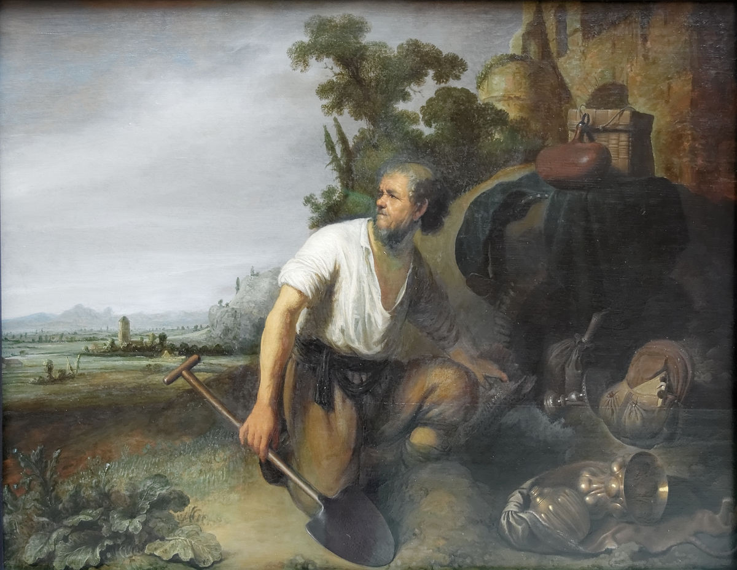
Buried Talents Matthew 25:14-30

Slide 9
Hidden Talents
What are talents meant to represent?
Romans 12:6-8
Abilities – 1 Corinthians 14:3
Resources – 2 Corinthians 8:2
Efforts – Acts 4:36-37
Notes:
Ro 12:6 Having then gifts differing according to the grace that is given to us, let us use them: if prophecy, let us prophesy in proportion to our faith; 7 or ministry, let us use it in our ministering; he who teaches, in teaching; 8 he who exhorts, in exhortation; he who gives, with liberality; he who leads, with diligence; he who shows mercy, with cheerfulness.
1Co 14:3 But he who prophesies speaks edification and exhortation and comfort to men. 4 He who speaks in a tongue edifies himself, but he who prophesies edifies the church.
2Co 8:2 that in a great trial of affliction the abundance of their joy and their deep poverty abounded in the riches of their liberality.

Slide 10
Hidden Talents
Why do we bury our talents?
The wrong fear
Resenting the work
Obsessed with perfection
Ignorance to its presence

Slide 11
The Wrong Fear
“I was afraid….”
We are to fear God – 1 Peter 2:17
We are to fear His wrath
God expects our best efforts
Notes:
1Pe 2:17 Honor all people. Love the brotherhood. Fear God. Honor the king.

Slide 12
The Lazy Servant
“You… lazy servant”
We are servants of God – 2 Timothy 2:15
We are expected to be diligent
We are expected to be working
Notes:
2Ti 2:15 Be diligent to present yourself approved to God, a worker who does not need to be ashamed, rightly dividing the word of truth.

Slide 13
Needing Perfection
Is it possible he needed a perfect chance?
God desires actual effort – Matthew 21:28
Too many wait for a perfect moment
Often we need to make opportunities
Notes:
Mt 21:28 ¶ "But what do you think? A man had two sons, and he came to the first and said, 'Son, go, work today in my vineyard.'
29 "He answered and said, 'I will not,' but afterward he regretted it and went.
30 "Then he came to the second and said likewise. And he answered and said, 'I go, sir,' but he did not go.
31 "Which of the two did the will of his father?" They said to Him, "The first." Jesus said to them, "Assuredly, I say to you that tax collectors and harlots enter the kingdom of God before you.

Slide 14
Needing Perfection
Is it possible it was lost?
We all have talents – Romans 12:3
We are unaware of our ability
We do not see an ability
Notes:
Ro 12:3 For I say, through the grace given to me, to everyone who is among you, not to think of himself more highly than he ought to think, but to think soberly, as God has dealt to each one a measure of faith.

Slide 15
Your Talents
Self examination
1) What are my talents?
2) How can I grow my talents?
3) What misuses my talents?
4) What restrains my talents?
Notes:
Galatians 6:7 Do not be deceived, God is not mocked; for whatever a man sows, that he will also reap.
1 Corinthians 15:33 Do not be deceived: "Evil company corrupts good habits."
1 Corinthians 6:9 Do you not know that the unrighteous will not inherit the kingdom of God? Do not be deceived. Neither fornicators, nor idolaters, nor adulterers, nor homosexuals, nor sodomites, nor thieves, nor [the] covetous, nor drunkards, nor revilers, nor swindlers, shall inherit the kingdom of God.

Slide 17
Buried Opportunity
The opportunity to obey the Gospel
To hear and believe
To confess Jesus as Lord
To repent
To be baptized
Notes:
Galatians 6:7 Do not be deceived, God is not mocked; for whatever a man sows, that he will also reap.
1 Corinthians 15:33 Do not be deceived: "Evil company corrupts good habits."
1 Corinthians 6:9 Do you not know that the unrighteous will not inherit the kingdom of God? Do not be deceived. Neither fornicators, nor idolaters, nor adulterers, nor homosexuals, nor sodomites, nor thieves, nor [the] covetous, nor drunkards, nor revilers, nor swindlers, shall inherit the kingdom of God.

Slide 18
Buried Opportunity
The opportunity to obey the Gospel
What if we don’t take the opportunity
Satan takes away the opportunity
Mark 4:15
Notes:
Mr 4:15 "And these are the ones by the wayside where the word is sown. When they hear, Satan comes immediately and takes away the word that was sown in their hearts.

Slide 19
Buried Opportunity
The opportunity to obey the Gospel
What if we don’t take the opportunity
Satan takes it away
Mark 4:15
Notes:
Mr 4:15 "And these are the ones by the wayside where the word is sown. When they hear, Satan comes immediately and takes away the word that was sown in their hearts.

Slide 20
Buried Opportunity
The opportunity to obey the Gospel
What if we don’t take the opportunity
Don’t miss the opportunity:
To be buried in Him
Notes:
Mr 4:15 "And these are the ones by the wayside where the word is sown. When they hear, Satan comes immediately and takes away the word that was sown in their hearts.

